Slide 1




















Venue: Jaipur
DJB Jal Manthan Conclave 2026
Capacity Building, Leadership & Motivation
Theme Lead
Team Lead
Ms. Swetika Sachan, IAS, Member (A)
Sh. Manoj Sharma,
Director (Yamuna Rejuvenation)
Working Group - Theme 3
Sh. Vinod Kumar Singh, Deputy Director (LW)
Sh. Rajmani Singh, Executive Engineer
Ms. Rachna, Junior Engineer
Mr. Vikas Sharma & Mr. Raghvenrda Sharma
Mrs. Kanika Tandon (KPMG)
Mr. Yashashvi Swami (KPMG)

Slide 2










ओ३म् स्वस्ति पन्थामनु चरेम सूर्याचन्द्रमसाविव । पुनर्ददताघ्नता जानता सङ्गमेमहि ॥ ( ऋग्वेद)
"हम सदाचार और कल्याण के शुभ मार्ग पर चलें, ठीक वैसे ही जैसे सूर्य और चंद्रमा बिना किसी त्रुटि और निस्वार्थ भाव से प्रकाश और शीतलता प्रदान करते हैं। हम समाज में पुन: पुन: दान देने वाले (उदार), किसी की हिंसा न करने वाले (अहिंसक) और ज्ञानवान (विद्वान) लोगों के साथ मिलकर चलें और उनकी संगति प्राप्त करें।"

Slide 3








DJB Jal Manthan Conclave 2026
Jaipur | 14–16 September 2026
Capacity Building
Leadership & Motivation
Future Ready DJB
Empowering DJB's workforce for tomorrow
Inspiring high performance across all levels
Accountable, agile & strategically aligned

Slide 4




Capacity Building: A Strategic Framework for a Future-Ready DJB
DJB faces gaps in leadership depth, workforce motivation & accountability needed to meet 2047 water security goals
A three-pillar framework: Capacity Building, Leadership & Motivation anchored in phased roadmaps through 2047
A high-performing, accountable & future-ready DJB delivering equitable water services to all Delhi citizens
Why Transformation Is Needed
The Proposed Approach
Expected Organizational Impact

Slide 5

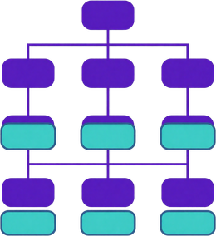

Navigating DJB's Strategic Landscape
Operational Complexity
Governance Gaps
Future-Ready Vision
Managing aging infrastructure & rapid urban demand growth
Bridging accountability, capacity & leadership deficits
Building a high-performing, citizen-centric DJB by 2032

Slide 6



Capacity Building
Three-Pillar Strategic Framework
Core Architecture for a Future Ready, Accountable & High Performing DJB
Capacity Building
Leadership & Motivation
Accountability & High Performance
Skilling workforce for operational excellence & future readiness
Inspiring purpose-driven leaders at every level of DJB
Embedding measurable outcomes & a culture of excellence

Slide 7
DJB Capacity Building: Six Priority Capability Areas
Technical & Engineering Capability
Managerial & Leadership Skills
Strengthening core water & sewerage operations
Building future-ready leadership at all levels
Digital & Data Management
Customer Service Excellence
Leveraging MIS, GIS, AI & smart monitoring tools
Improving grievance redressal & citizen satisfaction
Governance & Accountability
Operational & Financial Capacity
Embedding transparency & result-based accountability
Optimizing NRW reduction & revenue efficiency

Slide 8





Leadership Development Curriculum
Strategic Leadership
Team Leadership
Decision-Making
Change Management
Field Leadership
Vision, policy alignment & institutional governance
Team building, Skill Enhancement & staff motivation
Data-driven analysis & crisis resolution skills
Leading reform, resilience & adaptive thinking
On-ground operations & service delivery excellence

Slide 9





Employee Motivation & Engagement Framework
Recognition & Reward Culture
Career Growth & Development
Empowerment & Ownership
Wellbeing & Work-Life Balance
Purpose-Led Engagement
Celebrating performance milestones and service excellence
Structured pathways for promotion and skill advancement
Delegating authority to drive accountability at every level
Health, welfare and a supportive workplace environment
Connecting DJB staff to the mission of water for all

Slide 10



















Workforce Ecosystem
Distinct workforce groups, one integrated mission for reliable and equitable water services
01
Engineering Workforce
02
Field Workforce
Planning, Design, Asset management, Technical Standards, Innovation, and Infrastructure Resilience.
Operations, Maintenance, Emergency Response, Safety, Mechanisation, and Dependable Service Delivery.
03
Administrative Workforce
04
Customer Interface
Governance, Finance, HR, Procurement, Compliance, Coordination, and Institutional Support.
Grievance Redressal, Communication, Service Access, Responsiveness, Citizen Trust & Feedback Loops.
A future-ready DJB aligns every workforce segment around one service promise: safe, reliable and citizen-centric water management.

Slide 11







Capacity Building
Self-Development - Enabling Continuous Individual Growth
Individual Development Plans
Mentoring & Training
Digital Learning Ecosystem
Individual Proficiency Review
Personalized IDP for every DJB officer & staff
Senior leaders guiding next-gen talent using platforms like Karmayogi
e-Learning, AI, MOOCs & virtual skill modules
360° feedback & gap-based learning paths

Slide 12

















DJB | JAL MANTHAN CONCLAVE 2026
Occupational Mental Health: An Emerging Challenge & Why Counselling Should Become Institutional Policy
01
Emerging challenge
02
Why it matters
03
Why counselling should be institutional policy
04
Policy architecture
  Confidential counselling access (in-person/virtual)
  Operational pressure and high accountability
  Impacts employee wellbeing and morale
  Normalizes support-seeking as a sign of strength
  Trained managers to recognize and respond
  24 X 7 public-service demands
  Affects safety and decision-making
  Ensures confidentiality and psychological safety
  Clear referral pathways to professional support
  Frequent Emergencies and unpredictable situations
  Reduces service reliability and citizen satisfaction
  Provides equitable access across field and office staff
  Peer‑support and awareness programmes
  Organizational change and role transitions
  Strains teamwork and workplace relationships
  Enables early intervention and timely support
  Periodic wellbeing reviews and feedback loops
  Fatigue, burnout, anxiety, and reduced concentration
  Increases absenteeism and affects retention
  Reduces stigma and builds a caring workplace culture
  Clear escalation protocols for high-risk situations
Institutionalising counselling strengthens a resilient, healthy and high-performing DJB workforce.
DJB | Water for All: Conserve, Connect, Care
Delivering Today • Sustaining Tomorrow

Slide 13




















DJB | Jal Manthan Conclave 2026
Why Legal Compliance Must Become a Leadership Competency
01
Supreme Court Judgement – Dr. Balram Singh vs Union of India (2023)
02
PEMSR Act, 2013-The Prohibition of Employment as Manual Scavengers and their Rehabilitation
03
NAMASTE Scheme — National Action for Mechanised Sanitation Ecosystem
04
Leadership Implications for DJB
  Prohibit employment as manual scavengers
  Strict Compliance ownership at every level
  Risk-based planning for sewer and septic-tank work
  Documented SOPs and permits
  Contractor accountability
  Incident reporting
  Worker consultation
  Audits and continuous capability building.
  Treat sanitation-worker safety, eradication of manual scavenging, mechanization and accountability as non-negotiable leadership responsibilities.
  Promote safe, mechanized sanitation
  Worker formalization
  Protective equipment, training, health and safety
  Livelihood support.
  Prevent hazardous cleaning
  Identify and rehabilitate affected workers
  Ensure statutory duties are embedded in operations.
Legal compliance is not a checklist, it is a duty of leadership that protects lives, strengthens trust, and sustains lawful public service delivery.
DJB | Water for All: Conserve, Connect, Care
Delivering Today + Sustaining Tomorrow

Slide 14





Delivery Ecosystem: Institutional Enablers for Execution
Leadership
HR & L&D Unit
Operational Units & Field Teams
Technology Platforms
External Partners & Employee Participation
Senior DJB leadership championing capacity building & driving strategic accountability
Designing training calendars, competency frameworks & talent pipelines
Front-line execution, on-ground delivery & service performance
Digital MIS, AI, e-learning portals, MOOCs & real-time monitoring dashboards
Academia, NGOs, consultants & active staff engagement for co-creation

Slide 15







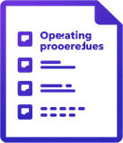
Capacity Building
Knowledge Management System
Knowledge Repository
Communities of Practice
SOPs & Operational Playbooks
Lessons Learned Framework
Innovation & Best Practice Sharing
Centralized digital library of DJB reports, data & technical resources
Cross-functional expert groups sharing domain knowledge
Standardised procedures for consistent service delivery
Capturing insights from projects, audits & field operations
Rewarding & scaling innovative solutions across DJB zones

Slide 16



















Capability Gap Analysis
Strengthening people, processes, systems and knowledge for safer, smarter and more resilient operations.
Operational Capability Gap Analysis
Safety Governance Gap Analysis
Leadership Capability Gap Analysis
Digital & Knowledge Management Gap Analysis
01
02
03
04
  Current challenges: emergency repairs often require multi-agency coordination
  The important safety reforms have not been institutionalized completely.
  Lack of role clarity across decision making authority.
  Improve interoperability of operational data
  Field reporting systems are not uniformly standardized
  Work Permit System
  Cross-functional decision-making during emergencies
  Standardize field reporting and dashboards
  Knowledge transfer between experienced and newly posted officers needs strengthening
  Nodal Safety Agency
  Risk-based supervision
  Connect preventive maintenance records with monitoring systems
  Preventive–maintenance data requires greater integration with digital monitoring
  Remaining focus: consistent field adoption, verification, contractor compliance, incident learning, and continuous improvement
  Accountability for safe work
  Leadership development grounded in field realities
  Adherence of current SOPs and operational playbooks
The next transformation priority is not only building systems,
but ensuring that capability, safety, leadership, data and knowledge work together in the field.
DJB
JAL MANTHAN
CONCLAVE 2026
Collaborate Innovate Transform

Slide 17
Capacity Building
Monitoring & Accountability Framework
Digital Key Performance Index (KPI) Mechanism
KPI Architecture
Role Clarity & Ownership
Cascaded KPIs from Leadership to field level
Defined accountability at every level
Real-Time Dashboards
Performance Dialogues
Live performance dashboards for all zones
Structured feedback loops between teams
Periodic Review & Governance
Corrective Action Tracking
Weekly, monthly & quarterly review cycles
Escalation matrix with time-bound resolution

Slide 18
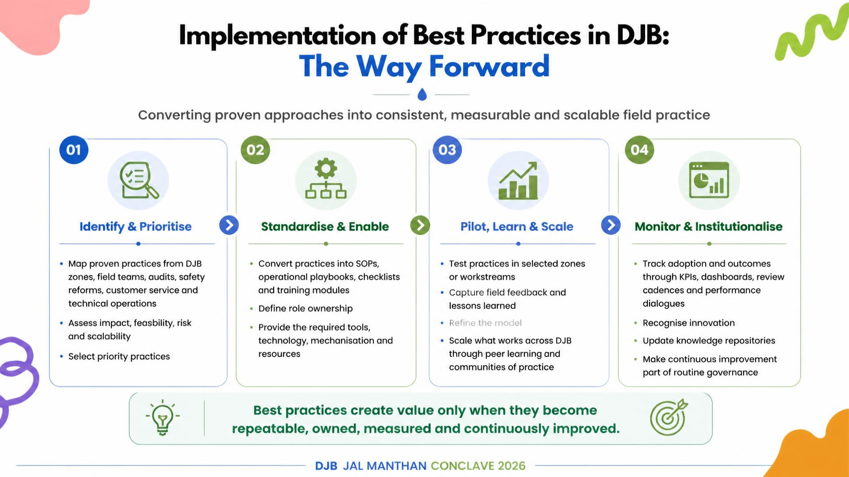

Slide 19



Phased DJB Restructuring Roadmap
2032 Foundation Stage Targets
Foundational Capability Systems
Leadership Pipeline Development
Performance & Accountability Mechanisms
Competency frameworks, training infrastructure & skill gap assessments in place across all DJB units
Identify & groom first cohort of mid-level leaders; succession plans drafted for key operational roles
KPI dashboards, performance review cycles & accountability protocols institutionalized in DJB

Slide 20



2037 Milestone: Scale-Up Stage Targets
Scaled Learning Ecosystem
Stronger Delivery Integration
Measurable Service Performance
Training Academy fully operational with structured training modules. 100% trained staff in leadership & technical skills
Cross-functional teams embedded across all zones; seamless coordination in water delivery
25% reduction in NRW; 100% grievance redressal within SLA; improved citizen satisfaction

Slide 21



2042 Milestone: Maturity Stage – DJB at Peak Performance
Robust Knowledge Systems
Data-Led Management
High-Performance Culture
Institutionalised Knowledge Management with self-sustaining learning loops across all DJB units
Real-time dashboards & AI-assisted decision-making driving operational excellence
Organisation-wide accountability, motivation & continuous improvement embedded in DJB

Slide 22



2047 Vision: Future-Ready DJB – The End State
Resilient & Citizen-Centric Organisation
Accountable & Innovative Leadership
Globally Benchmarked Water Utility
Universal 24x7 clean water access with zero grievance backlog
Data-driven governance, full fiscal autonomy & transparent accountability
World-class infrastructure, green operations & international best practices

Slide 23

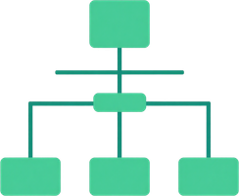



Strategic Recommendations for DJB Leadership
Immediate Leadership Action
Institutional Design Reform
Learning & Capacity Investment
Incentives & Motivation Policy
Governance & Monitoring
Appoint dedicated Chief Learning Officer & launch DJB Leadership Academy within 6 months
Restructure HR & training units with clear mandates, roles & accountability frameworks
Allocate min. 3% of annual budget to structured training, e-learning & field capability programs
Introduce performance-linked rewards, career progression paths & recognition systems for staff
Establish real-time dashboards, quarterly reviews & citizen feedback loops for accountability

Slide 24



Conclusion: Building a Future-Ready DJB
Invest in skills, training & continuous self-development at every level
Embed transparency, ownership & performance accountability across DJB
Drive sustainable water delivery through motivated, high-performing teams
Capable People
Accountable Leaders
Execution-Focused Culture

Slide 25


















Conclusion
Strengthening our people, systems and practices is the foundation for a resilient, efficient and citizen-centric Delhi Jal Board. Our focus must remain on capability, compliance, accountability and collaboration—today and in the years ahead.
01
2
3
Invest continuously in people, leadership and institutional learning.
Make safety, legal compliance, wellbeing and accountability non-negotiable.
Align engineering, field, administrative and customer-interface teams around reliable, equitable and citizen-centred water services.
Build future-ready capabilities and leaders who drive performance and innovation.
Strengthen governance and culture to protect people, assets and trust.
One DJB. One Purpose. One Promise to Delhi.
Together, we can build a future-ready DJB.
DJB JAL MANTHAN CONCLAVE 2026

Slide 26











Thank You
“CAPABILITY” BUILDS CONFIDENCE,
“LEADERSHIP” BUILDS TRUST &
“TOGETHER”, THEY BUILD BETTER PUBLIC SERVICE.
DJB JAL MANTHAN CONCLAVE 2026

Slide 27

























Suggestions for a More Supportive & Future-Ready DJB
Practical employee-support, emergency-response and institutional-enablement measures
01
Sports & Recreational Facilities
02
Resident Engineers for Emergency Situations
Provide accessible sports, recreation and wellbeing facilities across DJB workplaces to support employee health, morale, teamwork and engagement.
Consider a Resident Engineer model for designated areas or critical assets to strengthen round-the-clock technical readiness, rapid response, local coordination and service continuity during emergencies.
03
Digital Platform for Orders & SOPs
04
Creche for Working Women
Create one searchable digital platform for institutional orders, circulars, policies, SOPs and operational playbooks, with version control and easy access for authorised staff.
Establish workplace creche support in line with applicable statutory guidelines and the Code on Social Security, helping working parents balance professional responsibilities and childcare.
05
Facilities for Differently Abled Staff
06
Statutory Employee Welfare Schemes
Ensure accessible infrastructure, workplace facilities, communication support and reasonable accommodations for differently abled employees as required under applicable rules.
Ensure effective implementation, awareness, monitoring and grievance support for employee welfare requirements, including social security, industrial safety and minimum wages.
A future-ready institution supports its people, strengthens emergency readiness, and makes rules, knowledge and welfare accessible in practice.

