Slide 1
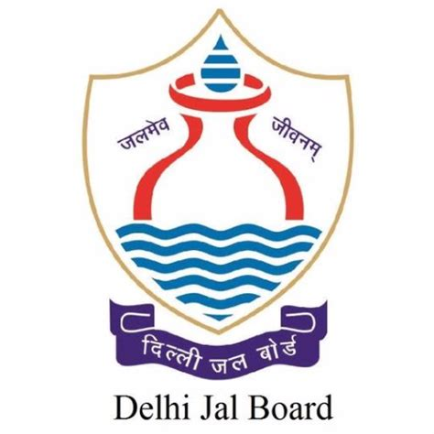
a
JAL MANTHAN 2026 a
A Participatory Visioning Workshop (Offsite)
मंथन से अभियान
Reclaimed Water Utilisation

Slide 2
Water and Wastewater Balance in Delhi
Parameter | Approx. MGD
Potable water supplied by Delhi Jal Board | 990–1,000
Estimated sewage generated (at ~80% return) | 792
Installed sewage treatment capacity (37 plants, 21 locations) | 814
Wastewater currently treated | 750
Reclaimed water tied to mandatory environmental flow to the Yamuna | 267
Reclaimed water not committed to environmental flow | 483
Reclaimed water currently reused | 120
Reuse schemes currently under planning | 114..5
Estimated untapped potential from existing treatment capacity | 248.5
483 MGD
Reclaimed water free of environmental-flow commitments
120 MGD
Reclaimed water actually reused today
114.5 MGD
Reuse schemes currently under planning
If left unchecked
Every litre of potable water used for washing, dust suppression, cooling or landscaping is a litre unavailable for drinking. Reclaimed water is the only supply Delhi can expand without a new source.
Continued use of potable water and groundwater for non-essential purposes will widen the supply–demand gap and deepen groundwater stress.
248.5 MGD
Estimated untapped potential from existing treatment capacity

Slide 3
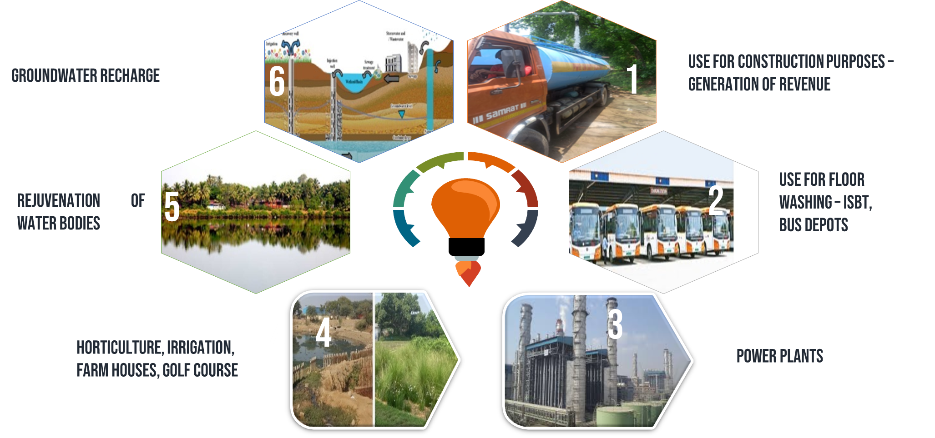
Existing Reclaimed Water Use
Reclaimed Water Service Areas
Core Zone extending from the treatment plant up to a distance of approx 2 to 5 km
Extended Zone extending beyond the Core Zone, up to a distance of approximately 8 to 10 kilometres from the treatment plant, by radial (straight-line) distance.
Other areas not falling in the Core Zone and Extended Zone but where there is demand for reclaimed water

Slide 4
Present Reclaimed Water Use in DJB
Purpose | Supply through | Source
Horticulture / DDA parks | Piped, tankers, ducts | All STPs
Irrigation | Piped | Coronation, Okhla, Keshopur STPs, etc.
Water bodies | Piped | Smriti Van, Sanjay Lake, Bansera, etc.
Industrial use | Piped | Okhla Waste-to-Energy Plant, PPCL Bawana , etc.
Bus washing | Piped | DTC depots
Construction | Tankers | All STPs
JAL MANTHAN 2026 • Reclaimed Water Utilisation | 6

Slide 5
Existing Reclaimed Water Use
~25%
of the reclaimed water available for reuse is put to beneficial use today
Current recipients
DDA · MCD · NDMC · CPWD · PWD · DTC · Pragati Power Corporation · Irrigation & Flood Control Department · private and institutional users
Takeaway The constraint is not a shortage of reclaimed water, but the absence of a systematic framework for service-area planning, conveyance and demand-side mandates.

Slide 6
GUIDELINE PRINCIPLES
Adopt the use of new technologies, improved data acquisition, research & development for institutionalizing reuse.
Adopt an incremental implementation approach based on available resources and the time to build institutional/technical capacity of ULB officials.
Establish ‘fit-for-purpose’ approach by establishing water quality standards customized to specific end- uses.
Establish the price of Reclaimed Water Reuse to be competitive with respect to alternative supplies and support for sustained O&M.
Provide clarity on the system of prioritization and allocation of Reclaimed Water Reuse based on social, economic and environmental benefits.
Encourage uptake though mandatory reuse provision and high quality of service provision.
Discourage/penalize for illegal extraction of groundwater specially where reuse of treated water is mandatory and available.
Adopt participatory planning processes involving stakeholders relevant to the end use of Reclaimed Water Reuse .
Adopt a risk-based precautionary approach to reuse & Incentivize compliance with quality standards. Address issues related to existing uses of used water.
Encourage projects to adopt a consistent approach with long-term commitments that provide stability for investors and end-users.

Slide 7





How Do We Increase Reclaimed Water Use?
Notify Service Areas
Build Conveyance
Mandate Substitution
Core and Extended Zones around compliant STPs, plus Sewer-Access and Priority Reuse Zones
Filling stations, registered tankers, and trunk and branch pipelines sequenced by demand
Bulk consumers, construction, golf courses, power plants and CETPs shift to reclaimed water
Assure Quality & Storage
Price It Right
Fit-for-purpose standards, on-site buffer storage, and city and zonal-scale resilience
Competitive tariffs, capital subsidies, and up to 100% early-adoption discounts

Slide 8
Who Must Switch, and By When
Category | Requirement
Public parks, playgrounds & golf courses | Blanket mandate within notified Service Areas; golf courses within 18 months
Construction projects ≥ 500 sq. m | Dust suppression, curing, compaction, machinery and road watering
Commercial complexes G+5 and above | Anti-smog gun / misting systems from onsite treatment or reclaimed supply
Thermal power plants within 50 km of a compliant STP | Mandatory use of treated sewage water, in order of proximity
Government schools & buildings | Cluster-level Decentralised Treatment Systems, phased rollout
Vehicle service stations, buses & metro washing | Reclaimed water use mandatory within notified Service Areas

Slide 9
Proposed Areas for Further Use — 114.5 MGD Under Planning
Sewage Treatment Plant | Receiving water body / reuse scheme | MGD
Okhla | NTPC Eco-Park; lake at Okhla STP | 33.0
Rohini Sector 25 | Lakes 1 & 2 at Rohini | 15.0
Rithala | Iradat Nagar | 15.0
Nilothi | Nilothi Lake | 10.0
Narela | Bakoli / Baktawarpur farmhouses; Tikri Khurd Lake | 6.5
Ghitorni | Sultanpur, Aya Nagar, Dera Mandi, Jaunapur farmhouses | 5.0
Kapashera | Pushpanjali & Westend Green farmhouses | 5.0
Pappankalan | Lakes at Pappankalan, Najafgarh, Dwarka WTP sites | 5.0
Chilla | Lake at Shahdara link drain | 5.0
Vasant Kunj | Mall Road, Gawa, Gadaipur farmhouses & other areas | 3.0
Mehrauli | Chhatarpur farmhouses | 2.0
Total |  | 114.5
Plus 90 MGD expected from new Decentralised STPs (DSTPs) coming online in the years ahead.

Slide 10
The Path to 100% Coverage
Bulk consumer substitution
By 2027
30%
By 2028
40%
By 2029
50%
By 2030
60%
By 2031
70%
By 2032
80%
By 2033
85%
By 2034
90%
By 2035
95%
By 2036
100%
Base year (2026): approximately 25% of available reclaimed water is currently in beneficial use.

Slide 11
Financing the Transition
Investment areas
Funding sources
Bringing STPs to prescribed treatment standard
Filling stations and metering infrastructure
Expansion of the reclaimed-water tanker fleet
On-site storage plus city and zonal-scale storage
Trunk mains, branch pipelines and canal rehabilitation
Decentralised Treatment Systems (incl. cluster-level)
Monitoring infrastructure and the digital portal
GNCTD budgetary allocation
AMRUT 2.0
National Mission for Clean Ganga
Swachh Bharat Kosh
Climate and green finance
Corporate Social Responsibility (CSR)
Public-Private Partnership models (DBO / BOOT / BOT / HAM)

Slide 12
Implementation Roadmap to 2036
Year 1 (2026-27)
2027 – 2030
2031 – 2035
2036
Foundation
Scale-Up
Deepen Reuse
Full Circularity
Constitute Steering & Implementation Committees
Conduct demand surveys; prepare City Action Plan
Notify the first Service Areas
Launch filling stations and the tanker system
Pilot substitution at NDMC and Cantonment Board
Beneficial use target rises from 30% to 60%
Bulk consumer substitution rises from 30% to 60%
Trunk and branch pipeline networks expand
Substitution mandates enforced in notified areas
Bulk consumer substitution rises from 70% to 95%
CETP / ETP reuse reaches 50% by 2031
Tertiary / advanced treatment where justified
City and zonal storage integrated with lake rejuvenation
100% beneficial use or planned environmental placement
100% bulk consumer substitution
CETP / ETP reuse reaches 70%
City-wide reclaimed water network fully operational

Slide 13
Jal Sankalp 2047 — Delhi's Water Security Vision
3.2 crore
401 MGD
1500 MGD
40 GPCD
Projected Delhi population by 2047
Additional water DJB must secure by 2047
Sewage treatment capacity targeted for 2047, from 814 MGD today
Potable-water cap proposed for new developments
What the vision commits Delhi to
Dual plumbing mandatory for new and regeneration projects over 2,000 sq. m or 10,000 L/day discharge
Zero Liquid Discharge required in land-pooling and Low Density Areas
Green-blue integration: rejuvenation of Yamuna floodplains, drains, wetlands and lakes across the Najafgarh, Trans-Yamuna and Barapullah basins
Source: Draft Master Plan for Delhi-2047 (MPD-2047), Delhi Development Authority.

Slide 14
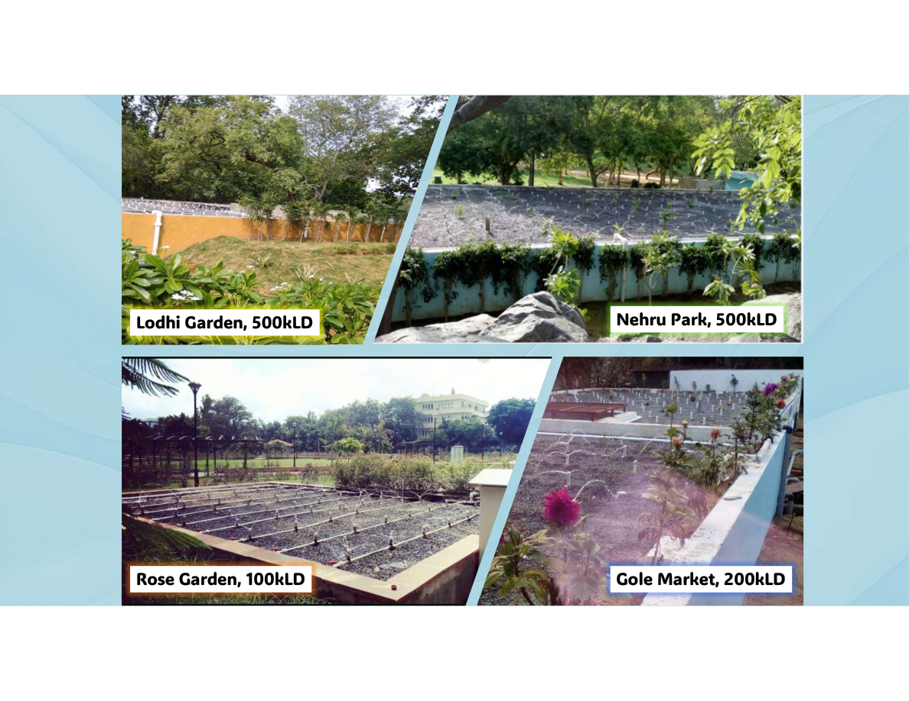
NDMC Project Locations

Slide 15
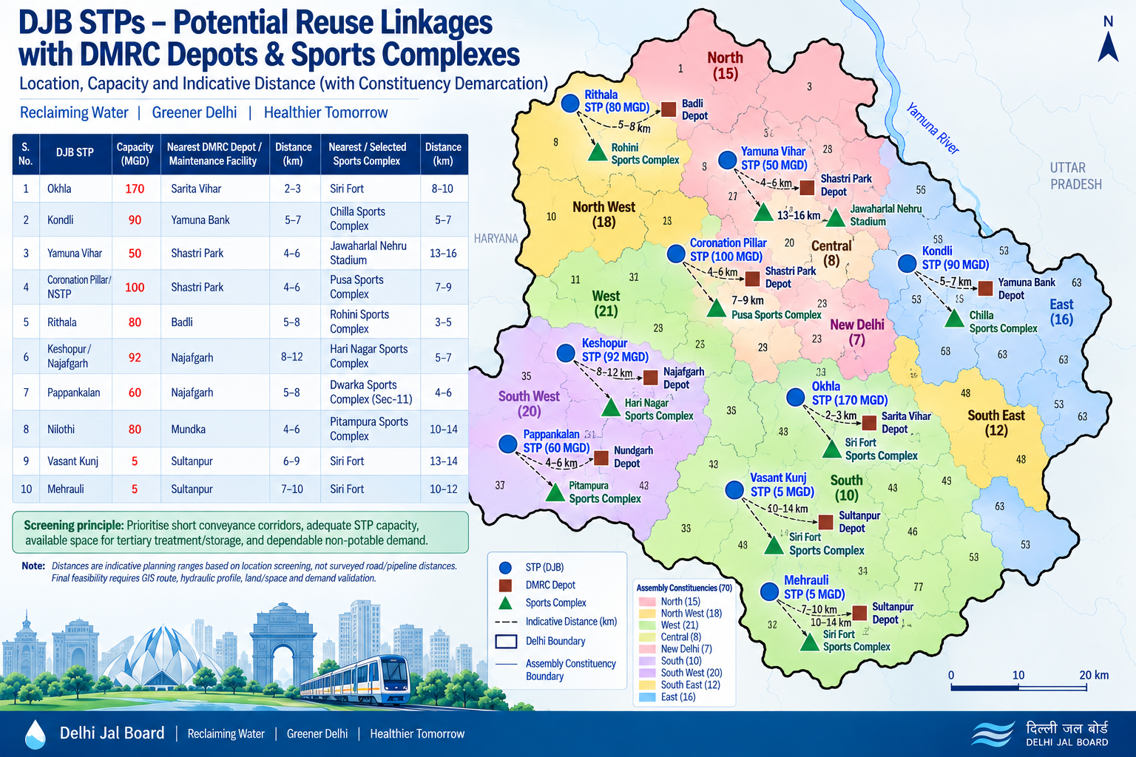

Slide 16
DJB STPs – Potential Reuse Linkages with DMRC Depots & Sports Complexes
Indicative screening based on DJB STP capacity, location and proximity to DMRC depots and DDA sports complexes.
S. No. | DJB STP | Capacity (MGD) | Nearest DMRC Depot / Maintenance Facility | Distance (km) | Nearest / Selected Sports Complex | Distance (km)
1 | Okhla | 170 | Sarita Vihar | 2–3 | Siri Fort | 8–10
2 | Kondli | 90 | Yamuna Bank | 5–7 | Chilla Sports Complex | 5–7
3 | Yamuna Vihar | 50 | Shastri Park | 4–6 | Jawaharlal Nehru Stadium | 13–16
4 | Coronation Pillar / NSTP | 100 | Shastri Park | 4–6 | Pusa Sports Complex | 7–9
5 | Rithala | 80 | Badli | 5–8 | Rohini Sports Complex | 3–5
6 | Keshopur/Najafgarh | 92 | Najafgarh | 8–12 | Hari Nagar Sports Complex | 5–7
7 | Pappankalan | 60 | Najafgarh | 5–8 | Dwarka Sports Complex (Sec-11) | 4–6
8 | Nilothi | 80 | Mundka | 4–6 | Pitampura Sports Complex | 10–14
9 | Vasant Kunj | 5 | Sultanpur | 6–9 | Siri Fort | 13–14
10 | Mehrauli | 5 | Sultanpur | 7–10 | Siri Fort | 10–12
Screening principle: Prioritise short conveyance corridors, adequate STP capacity, available space for tertiary treatment/storage, and dependable non-potable demand.
Note: Distances are indicative planning ranges based on location screening, not surveyed road/pipeline distances. Final feasibility requires GIS route, hydraulic profile, land/space and demand validation.
.

Slide 17
DMRC METRO COACH FLEET – SCALE OF WATER REUSE FOR TRAIN WASHING
Indicative assessment using published DMRC fleet and train-washing water-use data
2,410
Metro Coaches
1,416 BG + 910 SG
336
Train Sets
Fleet reported by DMRC
≈423 L
Water / Coach / Wash
Derived from 3,381 L per 8-car train
≈1,019 KLD
Theoretical Full-Fleet Wash
2,410 coaches × 423 L
Screening calculation: 2,410 coaches × 423 L/coach/wash ≈ 1,019,430 L ≈ 1,019 KLD
Important qualification
• 1,019 KLD is a theoretical upper-bound for washing the entire fleet once.
• Actual daily requirement depends on depot-wise trains/coaches washed and washing frequency.
• Final demand should be established jointly with DMRC through depot-level data.
Source: Economic Survey of Delhi 2025–26 / DMRC data (2,410 coaches as on 19 March 2026); DMRC Sustainability Report (published train-washing water-use reference). Figures are for preliminary screening.
Source: DMRC Sustainability Report: 3,381 L for an 8-car train; ~1,100 L recycled.

Slide 18
SPORTS COMPLEXES – PRELIMINARY WATER DEMAND
Screening estimate only; actual demand requires measured irrigated area and site consumption
ASSUMPTION
5 mm/day irrigation
1 mm × 1 ha
= 10 KL
5 mm/day
= 50 KL/ha/day
SITE AREA ≠
IRRIGATED AREA
Yamuna Sports Complex
27.5 ha
50% irrigated → ~688 KLD
Siri Fort Sports Complex
26.37 ha
50% irrigated → ~660 KLD
Dwarka Sector-11
8.10 ha
50% irrigated → ~203 KLD
Chilla Sports Complex
9.72 ha
50% irrigated → ~243 KLD
Pitampura Sports Complex
9.48 ha
50% irrigated → ~237 KLD
Formula: reclaimed-water demand (KLD) ≈ irrigated area (ha) × 50 KL/ha/day. Actual demand should account for rainfall, irrigation efficiency and measured consumption.

Slide 19
Worldwide Practice Adopted
Country / City | Project / Practice | Type of reuse
Singapore | NEWater | Industrial use + indirect potable reuse
USA – Orange County | GWRS | Indirect potable reuse / groundwater recharge
Namibia – Windhoek | Goreangab Water Reclamation Plant | Direct potable reuse
Australia – Queensland | Western Corridor Recycled Water Scheme | Industrial + water-supply augmentation
Israel | National wastewater reuse programme | Agricultural irrigation
California, USA | Municipal recycled-water programmes | Agriculture, landscape, industrial, recharge
Perth, Australia | Recycled water from WWTPs | Landscape & sports-ground irrigation
Belgium – Wulpen | Torelle Reuse Plant | Groundwater recharge
UK – Langford | Essex & Suffolk Water reuse scheme | Groundwater augmentation
South Africa – George | Water reclamation | Potable / non-potable supply
JAL MANTHAN 2026 • Reclaimed Water Utilisation | 9

Slide 20
Proposed Areas for Agricultural Use — 90 MGD Under Planning
On the outskirts of Delhi, Works of Setting Up of 29 New Decentralized Sewage Treatment Plants (DSTPs) have been awarded recently and work has commissioned at site. Most of these DSTPs are surrounded by agricultural farms. There is a huge potential of Reuse of reclaimed water from these DSTPs. Delhi Jal Board is planning to supply around 90 MGD to these farms for agricultural use by the end of year 2032 .

Slide 21
DJB is Planning to Onboard Empanelled Transaction Advisor
The objective of Transaction Advisor services is to assess the technical, commercial and financial viability of wastewater generation and their reuse potential.
Water Availability and STP Assessment
Water Quality and End-Use Suitability Assessment
Identification of suitable end-users and demand centre.
Stakeholder Consultation
Market assessment
Demand Assessment
Infrastructure creation/Augmentation assessment to meet the demand
Policy and Regulatory assessment
Development of commercially sustainable revenue models.
Preparation of a Detailed Project Report (DPR), structuring of the project under an appropriate framework (PPP/EPC model).
Exploring Viability Gap Funding (VGF) options.
Preparation of bid documents and providing transaction support up to selection of the preferred bidder and execution of agreement.

Slide 22
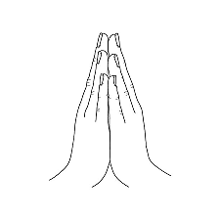
THANK YOU

