Slide 1

DELHI JAL BOARD
JAL MANTHAN 2047
Ensuring 24×7 Quality Water for Every Citizen
Water Augmentation Infrastructure • SCADA & Smart Operation
Theme lead: R.K. Lakhera (Member – Water)
Working group lead: Sunil Kr Singh, CE(WW)-2
Dalbir Singh, CE(M)-2
Members:
R.P. Meena, SE(E&M)
D.K. Jain, E.E. (Planning)
Mayank Bhardwaj, AE(E&M)
Pawan Sharma, Urban Reform Expert(KPMG)
Rajat Ranjan, Consultant(KPMG)

Slide 2




DELHI AT A DECISIVE POINT
"By 2047, DJB shall operate an integrated, resilient and intelligent water-supply system providing reliable 24×7 pressurised and quality water."
25M
~1,000
250
~50%
Residents Served
MGD Produced Today
MGD Demand-Supply Gap
Non-Revenue Water
From a water supply utility to a water security utility
Water Augmentation Infrastructure
SCADA &
Utility Automation
Smart Operations &
NRW Management

Slide 3
Journey of Water Supply in Delhi…
From single legacy plant to an integrated smart water supply system
1935–50s
2010s
Chandrawal
Phase-1(35)
Phase-2(55)
Okhla (20), Dwarka (50),
Bawana (20),
Recy. Plants (45), CWG (1)
1970s
1990s
Haiderpur
Phase-1 (100)
Haiderpur
Phase-2 (100)
1
2
3
4
5
6
7
8
1960s–90s
1980s
2000s
2020s
Wazirabad
Phase-1 (40)
Phase-2 (40)
Phase-3 (40)
Bhagirathi (100)
Sonia Vihar (140), Nangloi (40)
Technology Interventions
New WTP, SCADA & Upgrade
90 Years
35 MGD
1000 MGD

Slide 4
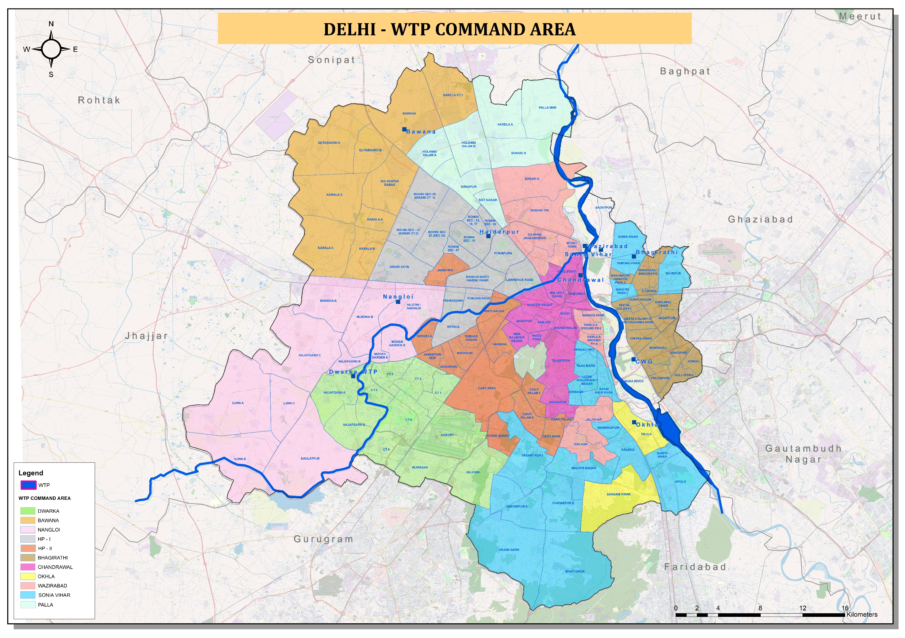

Slide 5
OLD vs. NEW CHANDRAWAL
OLD CHANDRAWAL
NEW CHANDRAWAL
Vintage
1935 & 1955
→
New-generation
(2026 Commissioning)
Capacity
~90 MGD
→
105 MGD
Monitoring
Legacy instruments
→
SCADA-enabled
Reliability
Ageing, breakdown risk
→
Modern & automated
Role
Legacy asset
→
Model for future DJB
From building water plants to building a resilient, intelligent water system
Notes:
Benchmark for future

Slide 6




DELHI'S WATER SUPPLY LANDSCAPE
Installed Capacity by WTP (MGD)
9 Major WTPs
Installed capacity of 821 MGD across the city, running on 865 MGD
20 Ranney Wells & 6240 Tube Wells, Yield 135 MGD
Groundwater-based supplementary production
16,200 km Network
Distribution mains carrying water to consumers
123 + 480 Reservoirs
Primary UGRs and secondary UGRs / booster stations

Slide 7

Challenges
Ammonia spikes in River Yamuna
Ageing, leak-prone assets
High NRW
Organic and inorganic pollution in Yamuna
Uneven tail-end pressure
Limited availability of raw water
Skilled manpower gaps
Non uniform SCADA coverage
Rapid population growth

Slide 8



BUILDING A WATER-SECURE DELHI
I
II
III
PILLAR I
PILLAR II
PILLAR III
Water Augmentation
Smart Operations & NRW Management
SCADA & Automation
Proposed and planned 235 MGD of new WTPs, upstream storage (Lakhwar, Renuka, Kishau) and 32.8 MGD of groundwater augmentation.
District Metered Areas, pressure management and active leak detection, predictive maintenance.
Real-time monitoring and supervisory control from source-to-consumer end.

Slide 9

PILLAR - I
Water Augmentation Infrastructure
235 MGD of new treatment capacity across three greenfield plants
Proposed WTP | Capacity (MGD) | Planning Zone
Chhattarpur | 80 | DDA Zone J
Najafgarh | 75 | DDA Zone L
Iradat Nagar | 80 | DDA Zone P-1
Total | 235 | —
Diversified Water Source
32.8 MGD Groundwater
Raw-Water Security
Munak–Haiderpur Main
463 tube wells across 11 locations & 12 maintenance zones
Renuka ji (~439 MGD), Lakhwar & Kishau upstream storage (to be allocated by UYRB)
Dedicated transmission line resulting in saving of 68 MGD raw water
Revision of 1994 Yamuna water sharing agreement
Actualization of Himachal Agreement (~ 268 MGD)

Slide 10
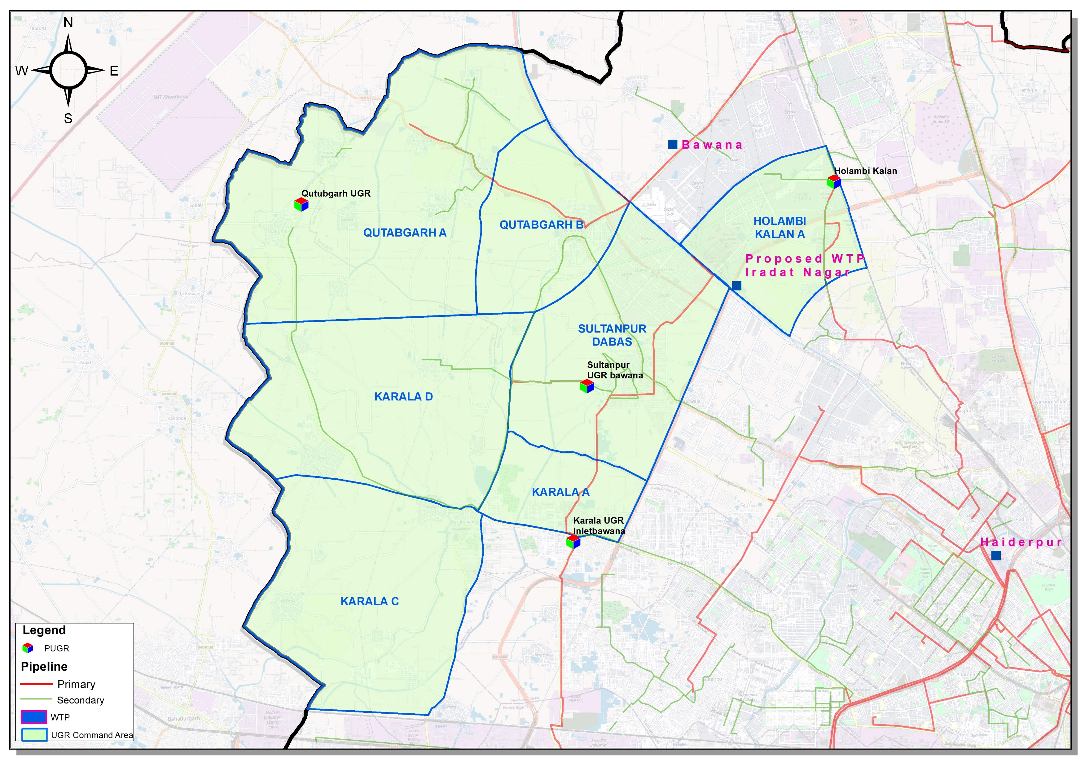
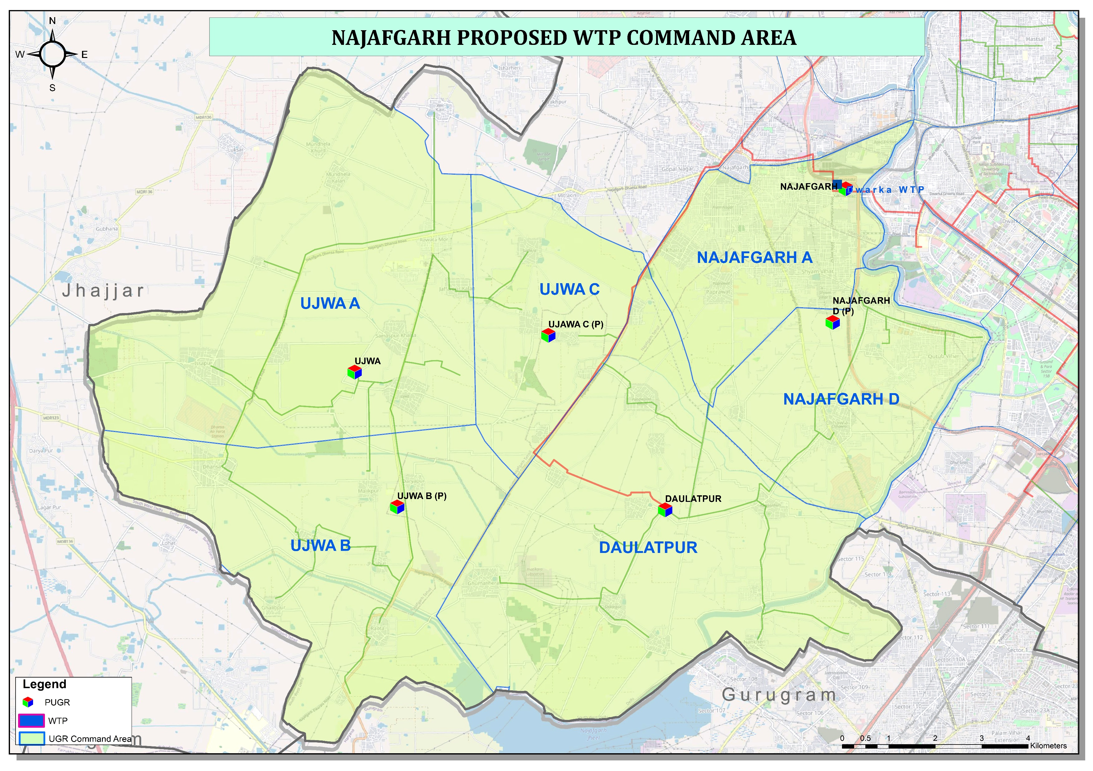
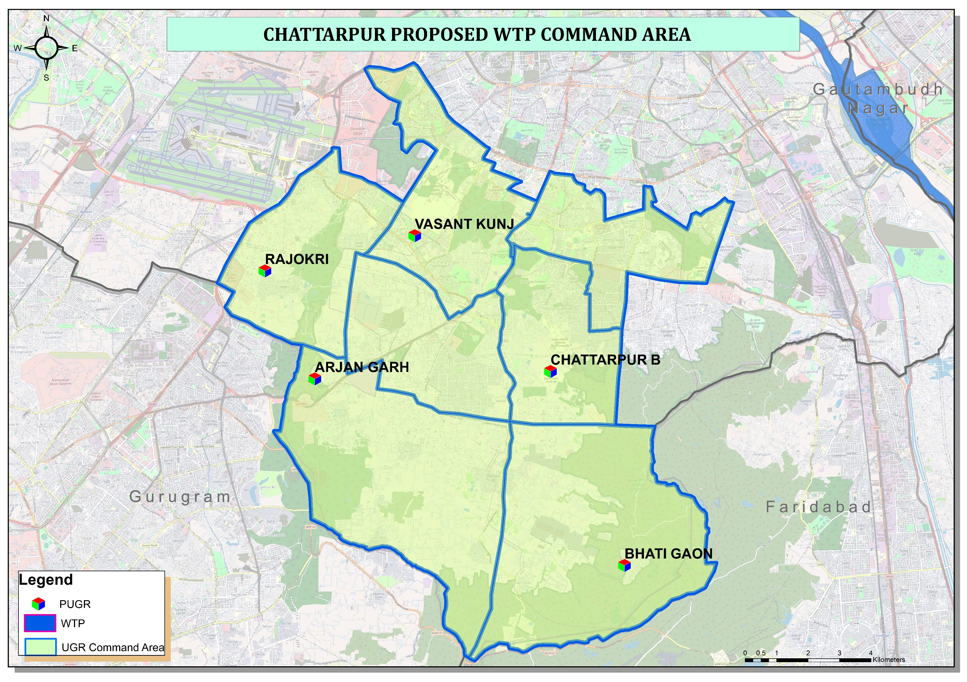
PILLAR - I
Water Augmentation Infrastructure
235 MGD of new treatment capacity across three greenfield plants
Iradat Nagar Proposed WTP
Najafgarh Proposed WTP
Chattarpur Proposed WTP

Slide 11

PILLAR - II
Smart Operations & NRW Management
Measure every drop, monitor every zone, detect every leak, optimise every asset
Tier 1: Trunk Mains
Water Balance Equation
Large steel & iron mains from WTPs to bulk storage; no tappings and house connections.
Water Lost (NRW) = Total Water Entering the DMA − Total Water Billed to Consumers
Tier 2: UGRs & Booster Stations
Receive bulk water from source, push into local zones at desired pressure.
Minimum Night Flow (MNF) Analysis
Monitored 2:00–4:00 AM to detect hidden leaks
Acoustic Leak Detection
Tier 3: District Metered Areas (DMAs)
Precisely locates and enables rapid repair
Metered pockets of ~1,000–3,000 houses with isolated boundaries.
Smart Pressure Control Valves
Regulate pressure to reduce bursts and leakage

Slide 12
NRW TRAJECTORY
From Nearly 50% Loss to a Global Benchmark
Drivers of Reduction
City-wide DMA rollout
Active leakage control & pressure management
Near Universal smart metering (AMR/AMI)
Regularization of unauthorized connections
Actualization of unaccounted flow.

Slide 13




PILLAR - III
SCADA & Automation
Real-time monitoring and supervisory control from source-to-consumer end, enabled via DJB’s ICCC.
Bulk Transmission & Treatment
Reservoir Automation
Distribution & Metering
Fleet & Tanker Tracking
Smart flow meters at WTPs and raw-water pipelines.
Pressure transmitters, level sensors, actuator valves at UGRs.
AMI/AMR smart meters, DMA boundary flow meters, data loggers.
GPS enabled tracking and RFID filling points.
Value Chain
Source → WTP → Transmission → UGR → Pumping Station → DMA → Consumer

Slide 14
DIGITAL TRANSFORMATION
One Utility, One Data Platform, One Ecosystem
DJB proposes a Delhi Water Operations & Intelligence Centre (ICCC) as the central command hub of the future utility.
SC
GI
WQ
EE
SCADA
GIS
Water Quality
Energy Efficiency
• Real-time control of pumps, valves & reservoirs
• Automated alarms for equipment failure
• Digital mapping of pipelines & assets
• Supports leak detection & network planning
• Continuous monitoring of chlorine, turbidity & pH
• Automated alerts for contamination risk
• Tracks energy consumed per MLD pumped
• Optimises pump scheduling to cut cost
ICCC
Integrated Command & Control Centre as the single source of truth for DJB’s operations
CS
HM
NRW
BR
Customer Service
Hydraulic Models
Non-Revenue Water
Billing & Revenue
• Complaint tracking & resolution dashboard
• Mobile app & self-service for consumers
• Simulates network pressure & flow
• Guides capacity augmentation planning
• Tracks water losses from leaks & theft
• Prioritises zones for pipeline renewal
• Automated meter reading & billing
• Real-time revenue & collection dashboard

Slide 15





FUTURE TECHNOLOGIES
Emerging Technologies for Future Water Operations
Internet of Things
AI & Machine Learning
Predictive Maintenance
Dense sensor networks across plants, reservoirs and consumer premises.
Demand forecasting, NRW reduction, pump/reservoir optimisation.
Condition-based monitoring shifting corrective to preventive care.
Digital Twin
Drone & Satellite Monitoring
Cloud & Edge Analytics
Virtual hydraulic models to simulate investments and emergencies.
Rapid inspection of facilities and subsurface leak detection.
Scalable data management with low-latency edge processing.

Slide 16

GOVERNANCE
Institutional Reform & Capacity Building
Performance-Based Governance
Asset & Data Governance
Capacity Building
Shift from maintenance-based operations to KPI-driven network management.
GIS-based digital asset register aligned with ISO 55001, plus a cybersecurity framework for SCADA systems.
Jal Sankalp Water Academy in partnership with educational institutions.
Water Availability & Pressure · NRW · Leak Response Time · Water Quality · Equipment Uptime · Complaint Resolution · Energy Efficiency
Key Performance Indicators

Slide 17

CITIZEN SERVICES
Grievance Redressal Mechanism
Multi-Channel Citizen Access
Time-Bound Resolution
Transparency & Accountability
Toll-free helpline, DJB mobile app, WhatsApp bot and citizen portal for grievance registration.
Complaint categories mapped with resolution timelines, escalation matrix.
Real-time SMS/alerts, officer's accountability and dashboard.
Registration → Acknowledgement (within 24 hrs) → Field Verification → Time Bound Resolution → Citizen Feedback & Rating
Grievance Workflow

Slide 18



INVESTMENT
Financing Framework
Government of NCT of Delhi
Primary investor via state budget/DJB capex for augmentation, network expansion & treatment upgrades.
GoI Programmes
Central grants under JJM (Urban), AMRUT 2.0 & Jal Shakti schemes support coverage, NRW reduction & smart-tech pilots.
Multilateral Institutions
Long-tenor, low-cost debt from World Bank/ADB/JICA/AIIB for capital-intensive assets, typically routed via sovereign guarantee.
PPP & Revenue Enhancement
Performance based PPP contracts.
Treated-wastewater sales to reduce budgetary dependence.

Slide 19
PERFORMANCE ASSESSMENT
Vision 2047
Dimension | Current State (2026) | Desired 2047 State
Water availability | Demand-supply gap of ~250 MGD | Water-secure city
Non-Revenue Water | ~50% | < 15% (international benchmark)
Automation / SCADA | Partial, plant-level | Source-to-Consumer
Supply pattern | Intermittent | Universal 24×7 supply
Metering | Mechanical Meters | 100% smart metering
Asset management | Fragmented | GIS-based lifecycle management

Slide 20
ROADMAP
Mission Horizons to 2047
A Water-Secure Delhi
2047
Universal 24×7 water supply.
15% NRW.
22,938 kms pipeline network coverage.
100% SCADA Coverage
Integrated Water Security
2042
Expanding DMA and smart metering coverage across ~90% of the network.
~18% NRW, 95% SCADA Coverage
Secure the Raw-Water Base
2037
Commissioning of Lakhwar, Renukaji & Kishau upstream storage dams.
Scaling up of smart metering, DMA and SCADA coverage.
Commission the ICCC.
~25% NRW, ~80% SCADA Coverage
5 Year Action Plan
Commissioning of Chandrawal new and Dwarka WTP
Progress on 235 MGD New WTPs + 32.8 MGD groundwater + raw water augmentation;
100% SCADA coverage of WTPs + primary UGR/BPS real time monitoring;
DMA coverage ~25% of network
Munak–Haiderpur conveyance system.
~30% NRW, 50% SCADA Coverage, ICCC operational
2032

Slide 21
LEARNING FROM OTHERS
Best Practices
India's first fully private, 24x7 water supply city.
Real-time water quality checks build public trust in tap water.
Turns used water into clean supply through NEWater recycling.
Steady pipe upkeep and leak detection cut water loss for decades.
Smart sensors predict and fix pipe failures before they happen.
Nagpur
Puri
Singapore (PUB)
Tokyo & Phnom Penh
Thames, London

Slide 22
Thank You!
JAL SANKALP 2047 | DELHI JAL BOARD

